Slide 1
Estimation of Parameters
By: Basharat Mahmood
Department of Computer Science,
COMSATS University of Islamabad, Pakistan.

Slide 2
Outline
Introduction to Estimation
Estimation of Population Mean
Estimation of Difference between Population Means
Estimation of Population Proportion
Estimation of difference between Population Proportion
Estimation of Variance

Slide 3
Introduction to Estimation
The procedure of making judgment or decision about a population parameter is referred to as statistical estimation or simply estimation
a sample is selected from the population and the sample data are then used to estimate the population parameters.
The main purpose of estimation in statistics is to be able to measure the behaviour of data within a population

Slide 4
Introduction to Estimation …
Estimate: a number computed by using the data collected from a sample
Point estimate: A single statistic value that is the “best guess” for the parameter value
Interval estimate: An interval of numbers around the point estimate, that has a fixed “confidence level” of containing the parameter value. Called a confidence interval.
Estimator: formula used to compute an estimate

Slide 5
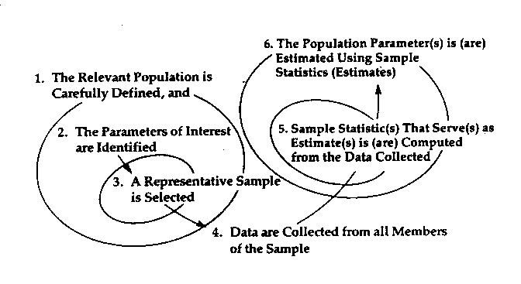
Introduction to Estimation …
The Estimation Process

Slide 6
Introduction to Estimation …
Interval Estimation: an inferential statistical procedure used to estimate population parameters from sample data through the building of confidence intervals
Confidence Intervals: a range of values computed from sample data that has a known probability of capturing some population parameter of interest

Slide 7
Introduction to Estimation …
Steps to Confidence Interval
Compute the sample statistic (e.g. a mean)
Compute the standard error of the mean
Decide about the level of confidence that is desired (usually 95% or 99%)
Find tabled value for 95% or 99% confidence interval
Multiply standard error of the mean by the tabled value
Form interval by adding and subtracting calculated value to and from the mean

Slide 8
Estimation of Population Mean
Mean estimation is a statistical inference problem in which a sample is used to produce a point estimate of the mean of an unknown distribution

Slide 9
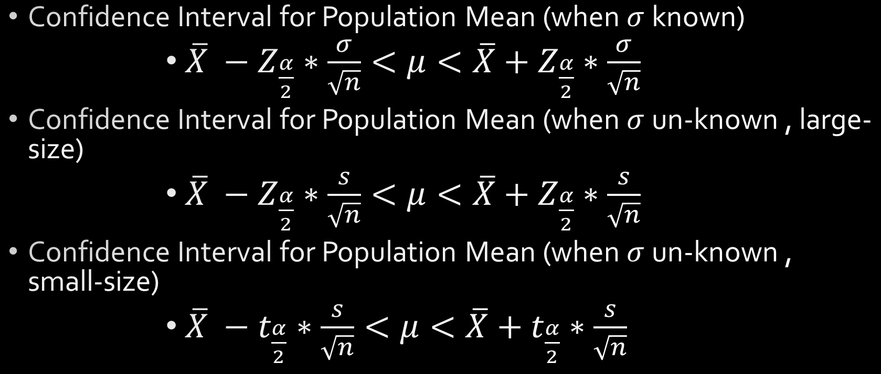
Estimation of Population Mean…
Confidence Interval for Population Mean (when $σ$ known)
$\overline{X} −Z_{\frac{α}{2}}∗\frac{σ}{\sqrt{n}}<μ<\overline{X}+Z_{\frac{α}{2}}∗\frac{σ}{\sqrt{n}}$
Confidence Interval for Population Mean (when $σ$ un-known , large-size)
$\overline{X} −Z_{\frac{α}{2}}∗\frac{s}{\sqrt{n}}<μ<\overline{X}+Z_{\frac{α}{2}}∗\frac{s}{\sqrt{n}}$
Confidence Interval for Population Mean (when $σ$ un-known , small-size)
$\overline{X} −t_{\frac{α}{2}}∗\frac{s}{\sqrt{n}}<μ<\overline{X}+t_{\frac{α}{2}}∗\frac{s}{\sqrt{n}}$

Slide 10
Estimation of Population Mean…
Example 1: Suppose we are interested in the mean scores on an exam. A random sample of 36 scores is taken and gives a sample mean (sample mean score) of 68 In this example we have the unusual knowledge that the population standard deviation is 3 points. Find a 95% and 99% confidence interval estimate for the population mean exam score (the mean score on all exams).

Slide 11
Estimation of Population Mean…
Example 2: Spring break can be a very expensive holiday. A sample of 80 students is surveyed, and the average amount spent by students is $593.84. The sample standard deviation is approximately $369.34. Construct a 92% confidence interval for the population mean amount of money spent by spring breakers.

Slide 12
Estimation of Population Mean…
Example 3: The contents of 7 similar containers of sulfuric acid are 9.8, 10.2, 10.4, 9.8, 10.0, 10.2 and 9.6 Litters. Find a 95% confidence interval for the mean content of all such containers.

Slide 13
3. Estimation of Difference between Population Means
The confidence interval for the difference in means provides an estimate of the absolute difference in means of the outcome variable of interest between the comparison groups
It is often of interest to make a judgment as to whether there is a statistically meaningful difference between comparison groups

Slide 14

3. Estimation of Difference between Population Means…
($1−α$)100% C.I limits for difference between Population Means (when $σ_{1},σ_{2}$are known)
$$\left({\overline{x}}_{1}−{\overline{x}}_{2}\right)−Z_{\frac{α}{2}}∗\sqrt{\frac{σ_{1}^{2}}{n_{1}}+\frac{σ_{2}^{2}}{n_{2}}}<μ_{1}−μ_{2}<\left({\overline{x}}_{1}−{\overline{x}}_{2}\right)+Z_{\frac{α}{2}}∗\sqrt{\frac{σ_{1}^{2}}{n_{1}}+\frac{σ_{2}^{2}}{n_{2}}}$$
($1−α$)100% C.I limits for difference between Population Means(when$σ_{1},σ_{2}$ are un-known , large-sample size)
$$\left({\overline{x}}_{1}−{\overline{x}}_{2}\right)−Z_{\frac{α}{2}}∗\sqrt{\frac{s_{1}^{2}}{n_{1}}+\frac{s_{2}^{2}}{n_{2}}}<μ_{1}−μ_{2}<\left({\overline{x}}_{1}−{\overline{x}}_{2}\right)+Z_{\frac{α}{2}}∗\sqrt{\frac{s_{1}^{2}}{n_{1}}+\frac{s_{2}^{2}}{n_{2}}}$$

Slide 15

3. Estimation of Difference between Population Means…
($1−α$)100% C.I limits for difference between Population Means (dependent samples, $σ_{1}=σ_{2}$ and un-known , small-sample size)
$$\left({\overline{x}}_{1}−{\overline{x}}_{2}\right)−t_{\frac{α}{2}}∗s_{p}\sqrt{\frac{1}{n_{1}}+\frac{1}{n_{2}}}<μ_{1}−μ_{2}<\left({\overline{x}}_{1}−{\overline{x}}_{2}\right)+t_{\frac{α}{2}}∗s_{p}\sqrt{\frac{1}{n_{1}}+\frac{1}{n_{2}}}$$
Where
$$s_{p}=\sqrt{\frac{\left(n_{1}−1\right)s_{1}^{2}+\left(n_{2}−1\right)s_{2}^{2}}{n_{1}+n_{2}−2}}$$
and
$${df=n}_{1}+n_{2}−2$$

Slide 16

3. Estimation of Difference between Population Means…
($1−α$)100% C.I limits for difference between Population Means (dependent samples, $σ_{1}≠σ_{2}$ and un-known , small-sample size)
$$\left({\overline{x}}_{1}−{\overline{x}}_{2}\right)−t_{\frac{α}{2}}∗\sqrt{\frac{s_{1}^{2}}{n_{1}}+\frac{s_{2}^{2}}{n_{2}}}<μ_{1}−μ_{2}<\left({\overline{x}}_{1}−{\overline{x}}_{2}\right)+t_{\frac{α}{2}}∗\sqrt{\frac{s_{1}^{2}}{n_{1}}+\frac{s_{2}^{2}}{n_{2}}}$$
Where
$$df= \frac{{\left(\frac{s_{1}^{2}}{n_{1}}+\frac{s_{2}^{2}}{n_{2}}\right)}^{2}}{\left[\frac{{\left(\frac{s_{1}^{2}}{n_{1}}\right)}^{2}}{n_{1}−1}\right]+\left[\frac{{\left(\frac{s_{2}^{2}}{n_{2}}\right)}^{2}}{n_{2}−1}\right]}$$

Slide 17

3. Estimation of Difference between Population Means…
($1−α$)100% C.I limits for difference between Population Means for paired observations
$$\overline{d}−t_{\frac{α}{2}}∗\frac{s_{d}}{\sqrt{n}}<μ_{d}<\overline{d}+t_{\frac{α}{2}}∗\frac{s_{d}}{\sqrt{n}}$$
Where,
$$s_{d}=\sqrt{\frac{n\sum{d_{i}^{2}}−{\left(\sum{d_{i}}\right)}^{2}}{n\left(n−1\right)}}$$

Slide 18
3. Estimation of Difference between Population Means…
Example 4: A standardized chemistry test was given to 50 girls and 75 boys. The boys made an average grade of 82 with a standard deviation of 8, while the girls made an average grade of 76 with a standard deviation of 6. Find 96% CI for the difference in population means.

Slide 19
3. Estimation of Difference between Population Means…
Example 5: A course in mathematics is taught to 12 students by the conventional classroom procedure. A second group of 10 students was given the same course by means of programmed materials. At the end of the semester the same examination was given to each group. The 12 students meeting in the classroom made an average grade of 85 with a standard deviation of 4, while the 10 students using programmed materials made an average of 81 with a standard deviation of 5. Find 90% CI for the difference between the population means, assuming the populations are approximately normally distributed with equal variances.

Slide 20
3. Estimation of Difference between Population Means…
Example 6: Records for the past 15 years have shown the average rainfall in a certain region of the country for the month of May to be 4.93 centimetres, with a standard deviation of 1.14 centimetres. A second region of the country has had an average rainfall in May of 2.64 with a standard deviation of 0.66 centimetres during the last 10 years. Find a 95% CI for the difference of the true average rainfall in these two regions, assuming that the observation come from normal populations with different variances.

Slide 21
3. Estimation of Difference between Population Means…
Example 7: Twenty college freshmen were divided into 10 pairs, each member of the pair having approximately the same IQ. One of each pair was selected at random and assigned to a mathematics section using programmed materials only. The other member of each pair was assigned to a section in which the professor lectured. At the end of the semester each group was given the same examination, and the following results were recorded (given in the table).
Find the 98% CI for the true difference in the learning procedures.
Pair | Programmed Material | Lectured
1 | 76 | 81
2 | 60 | 52
3 | 85 | 87
4 | 58 | 70
5 | 91 | 86
6 | 75 | 77
7 | 82 | 90
8 | 64 | 63
9 | 79 | 85
10 | 88 | 83

Slide 22
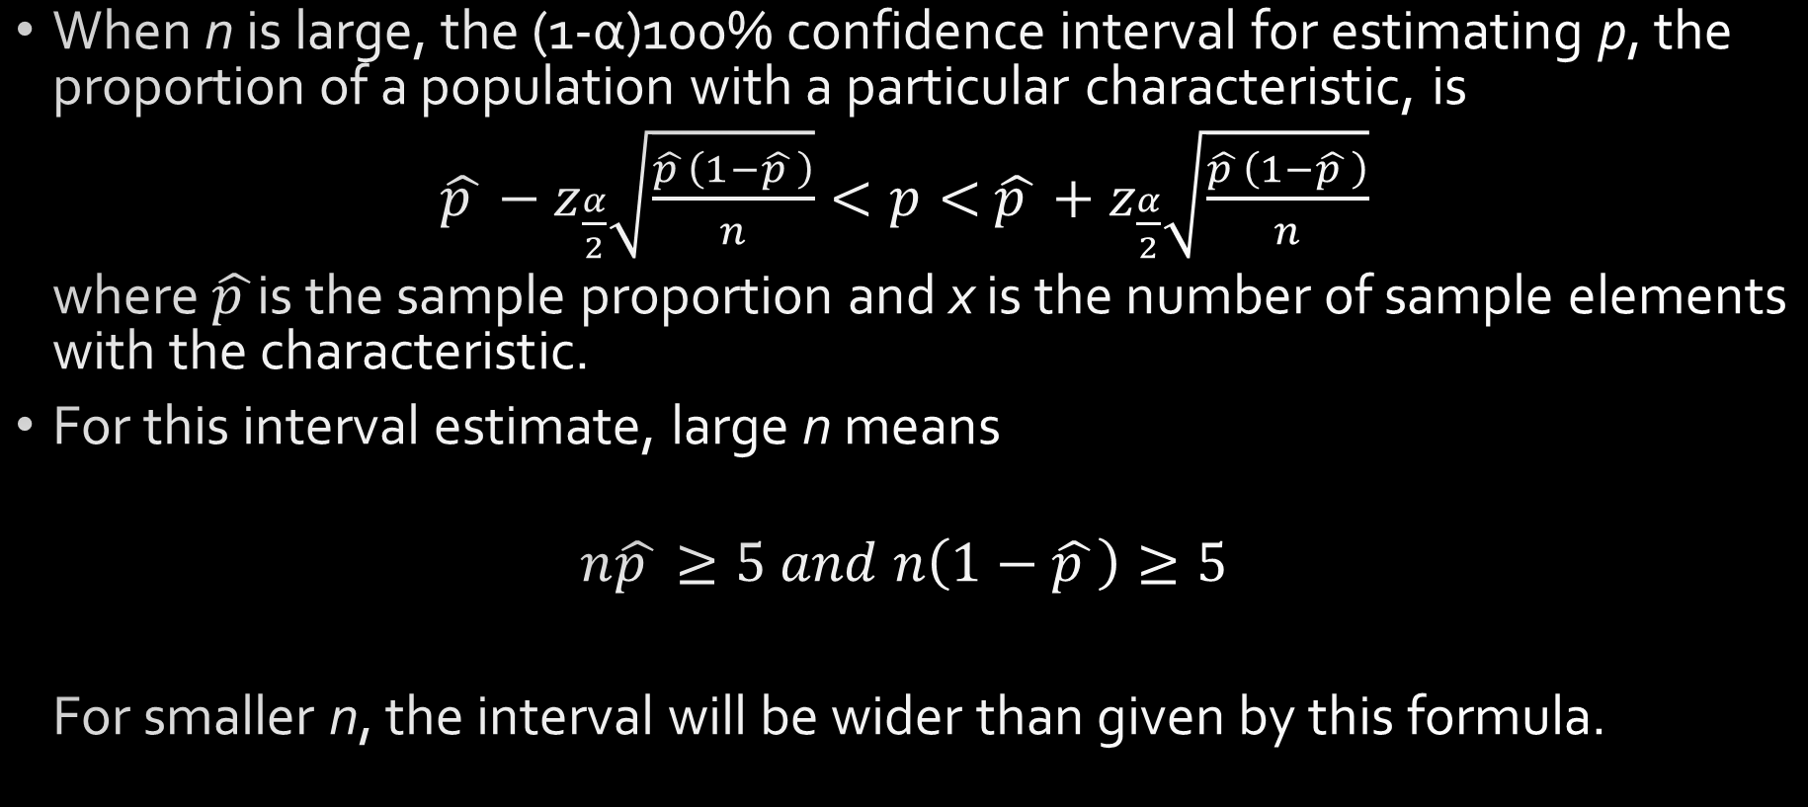
4. Estimation of Population Proportion
When n is large, the (1-α)100% confidence interval for estimating p, the proportion of a population with a particular characteristic, is
$\hat{p }−z_{\frac{α}{2}}\sqrt{\frac{\hat{p }\left(1−\hat{p }\right)}{n}}<p<$ $\hat{p }+z_{\frac{α}{2}}\sqrt{\frac{\hat{p }\left(1−\hat{p }\right)}{n}}$
where $\hat{p }$is the sample proportion and x is the number of sample elements with the characteristic.
For this interval estimate, large n means
$$n\hat{p }≥5 and n\left(1−\hat{p }\right)≥5$$
For smaller n, the interval will be wider than given by this formula.

Slide 23

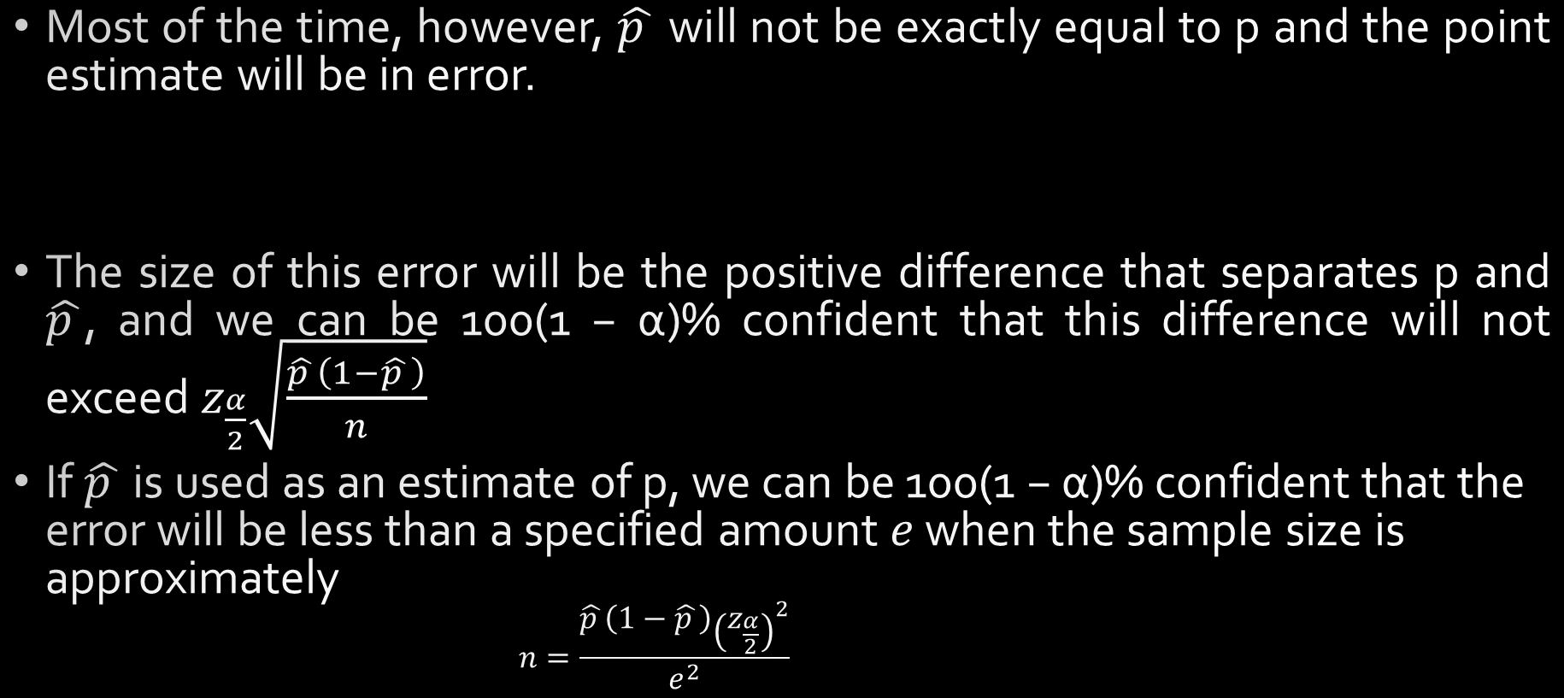
4. Estimation of Population Proportion…
Most of the time, however, $\hat{p }$ will not be exactly equal to p and the point estimate will be in error.
The size of this error will be the positive difference that separates p and $\hat{p }$, and we can be 100(1 − α)% confident that this difference will not exceed $z_{\frac{α}{2}}\sqrt{\frac{\hat{p }\left(1−\hat{p }\right)}{n}}$
If $\hat{p }$ is used as an estimate of p, we can be 100(1 − α)% confident that the error will be less than a specified amount $e$ when the sample size is approximately
$$n=\frac{\hat{p }\left(1−\hat{p }\right){\left(z_{\frac{α}{2}}\right)}^{2}}{e^{2}}$$

Slide 24
4. Estimation of Population Proportion…
Example 8: In a random sample of n = 500 families owning television sets in the city of Hamilton, Canada, it is found that x = 340 subscribe to HBO. Find a 95% confidence interval for the actual proportion of families with television sets in this city that subscribe to HBO.

Slide 25
4. Estimation of Population Proportion…
Example 9: How large a sample is required if we want to be 95% confident that our estimate of p in Example 8 is within 0.02 of the true value?

Slide 26
4. Estimation of Population Proportion…
Example 10: In a random sample of 1000 homes in a certain city, it is found that 228 are heated by oil. Find 99% confidence intervals for the proportion of homes in this city that are heated by oil
Example 11: How large a sample is needed if we wish to be 99% confident that our sample proportion in Example 10 will be within 0.05 of the true proportion of homes in the city that are heated by oil?

Slide 27
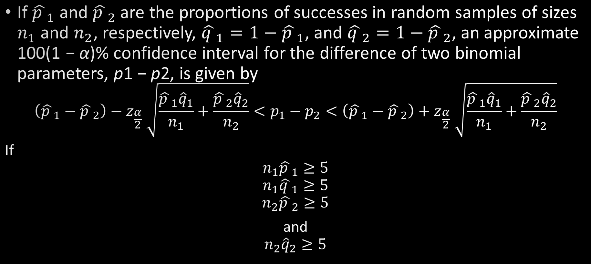
5. Estimating the difference between Population Proportions
If ${\hat{p }}_{1}$and ${\hat{p }}_{2}$ are the proportions of successes in random samples of sizes $n_{1}$ and $n_{2}$, respectively, ${{\hat{q }}_{1}=1−\hat{p }}_{1}$, and ${{\hat{q }}_{2}=1−\hat{p }}_{2}$, an approximate 100(1 − α)% confidence interval for the difference of two binomial parameters, p1 − p2, is given by
$$\left({\hat{p }}_{1}−{\hat{p }}_{2}\right)−z_{\frac{α}{2}} \sqrt{\frac{{\hat{p }}_{1}{\hat{q}}_{1}}{n_{1}}+\frac{{\hat{p }}_{2}{\hat{q}}_{2}}{n_{2}}}<p_{1}−p_{2}<\left({\hat{p }}_{1}−{\hat{p }}_{2}\right)+z_{\frac{α}{2}} \sqrt{\frac{{\hat{p }}_{1}{\hat{q}}_{1}}{n_{1}}+\frac{{\hat{p }}_{2}{\hat{q}}_{2}}{n_{2}}}$$
If
$${n_{1}\hat{p }}_{1}≥5$$
$${n_{1}\hat{q }}_{1}≥5$$
$${n_{2}\hat{p }}_{2}≥5$$
and
$${n_{2}\hat{q}}_{2}≥5$$

Slide 28
5. Estimating the difference between Population Proportions …
Example 12: A certain change in a process for manufacturing component parts is being considered. Samples are taken under both the existing and the new process so as to determine if the new process results in an improvement. If 75 of 1500 items from the existing process are found to be defective and 80 of 2000 items from the new process are found to be defective, find a 90% confidence interval for the true difference in the proportion of defectives between the existing and the new process.

Slide 29

6. Estimating the Variance: Single Sample
If a sample of size n is drawn from a normal population with variance $σ^{2}$ and the sample variance $s^{2}$ is computed, we obtain a value of the statistic $S^{2}$. This computed sample variance is used as a point estimate of $σ^{2}$.
If $s^{2}$ is the variance of a random sample of size n from a normal population, a 100(1 − α)% confidence interval for $σ^{2}$ is
$$\frac{\left(n−1\right)s^{2}}{χ_{\frac{α}{2}}^{2}}<σ^{2}<\frac{\left(n−1\right)s^{2}}{χ_{1−\frac{α}{2}}^{2}}$$
Where
df=n-1
$$s^{2}=\frac{n\sum_{i=1}^{n}{x_{i}^{2}}−{\left(\sum_{i=1}^{n}{x_{i}}\right)}^{2}}{n\left(n−1\right)}$$

Slide 30
6. Estimating the Variance: Single Sample
Example 13: The following are the weights, in decagrams, of 10 packages of grass seed distributed by a certain company: 46.4, 46.1, 45.8, 47.0, 46.1, 45.9, 45.8, 46.9, 45.2, and 46.0. Find a 95% confidence interval for the variance of the weights of all such packages of grass seed distributed by this company, assuming a normal population.

Slide 31

6. Estimating the Ratio of Two Variances
If $s_{1}^{2}$ and $s_{2}^{2}$ are the variances of independent samples of sizes $n_{1}$ and $n_{1}$, respectively, from normal populations, then a 100(1−α)% confidence interval for $\frac{σ_{1}^{2}}{σ_{2}^{2}}$is:
$\frac{s_{1}^{2}}{s_{2}^{2}}×\frac{1}{f_{\frac{α}{2}}\left(v_{1},v_{2}\right)}<\frac{σ_{1}^{2}}{σ_{2}^{2}}<\frac{s_{1}^{2}}{s_{2}^{2}}$ $f_{\frac{α}{2}}\left(v_{2},v_{1}\right)$
Where $v_{1}=n_{1}−1$ and $v_{2}=n_{2}−1$

Slide 32
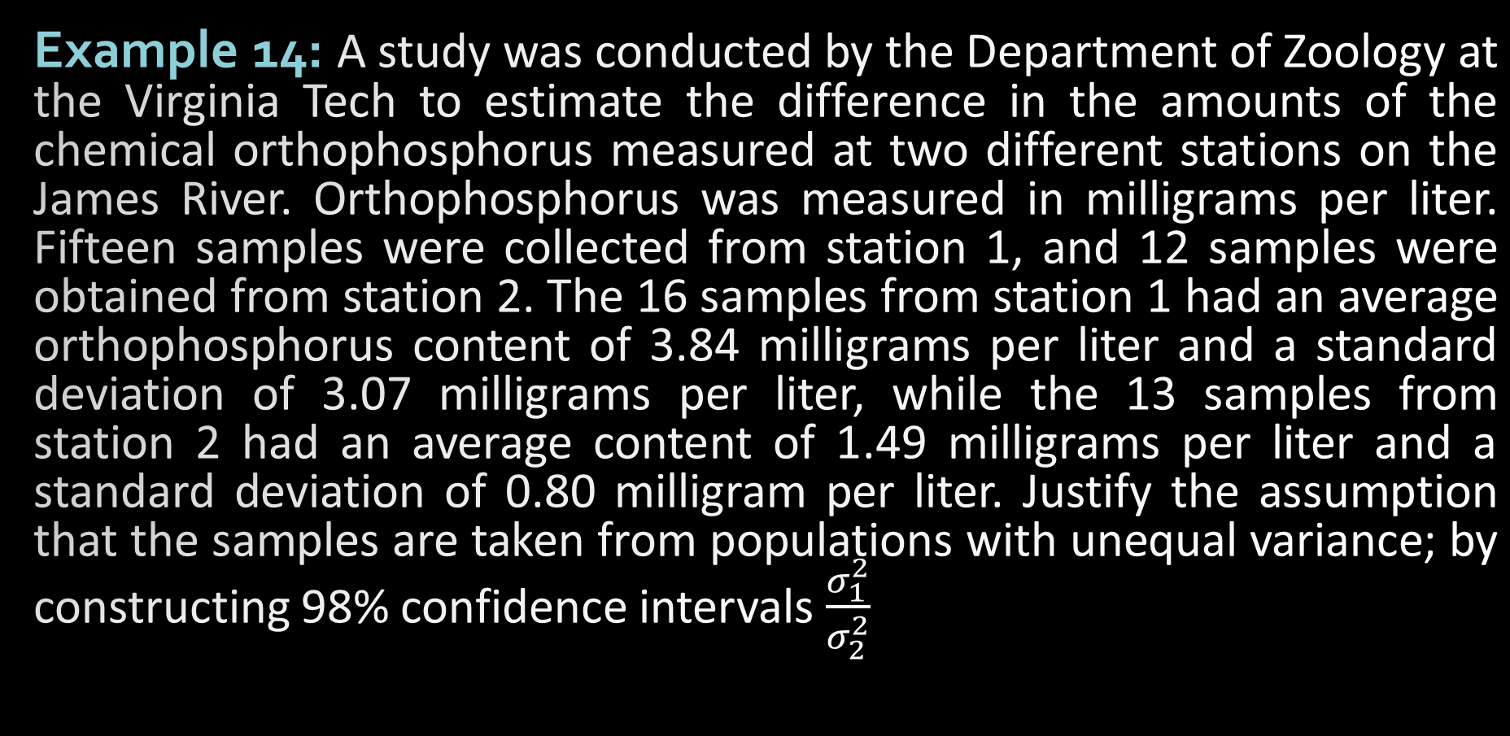
6. Estimating the Ratio of Two Variances
Example 14: A study was conducted by the Department of Zoology at the Virginia Tech to estimate the difference in the amounts of the chemical orthophosphorus measured at two different stations on the James River. Orthophosphorus was measured in milligrams per liter. Fifteen samples were collected from station 1, and 12 samples were obtained from station 2. The 16 samples from station 1 had an average orthophosphorus content of 3.84 milligrams per liter and a standard deviation of 3.07 milligrams per liter, while the 13 samples from station 2 had an average content of 1.49 milligrams per liter and a standard deviation of 0.80 milligram per liter. Justify the assumption that the samples are taken from populations with unequal variance; by constructing 98% confidence intervals $\frac{σ_{1}^{2}}{σ_{2}^{2}}$

Slide 33
References
Chapter 9, Introduction to statistics, Ronald E. Walpole.

